Slide 1
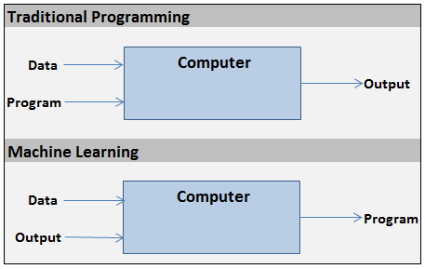

Slide 2


x₁
w₁
Summation
Activation (i.e. Step)
x₂
w₂
x₃
w₃
Output
x₄
w₄
Σ
y
Inputs
w₅
x₅
.
.
.
w_{n}
h(X) = x₁w₁ + x₂w₂ + … + x_{n}w_{n}
x_{n}
1, if h(X) >= 0
y =
Weights
0, if h(X) < 0

Slide 3
